Slide 1
Data-Driven 3D Shape Processing Joint Shape Segmentation
Prof. Yi Fang
yfang@nyu.edu
Spring, 2016

Slide 2
Announcement
Project 3 for joint and consistent segmentation will be released this week
Final projection presentation on April 14th
Intermediate Report of Final project will be due on April 23rd. Please refer to project description for the details.

Slide 3
Today’s Content
3D shape and its segmentation
Related Segmentation algorithms
Data Driven consistent segmentation
Deep Learning for consistent shape segmentation
Note & acknowledgment: Some of today’s lectures are referred to the following sources:
Qixing Huang, etc, Joint Segmentation with Linear Programming, Link
Jian Gao, etc, Clustering Ensemble, Link
L. Cosmo, etc, Consistent partial matching of shape collections via spars modeling, 2016

Slide 4
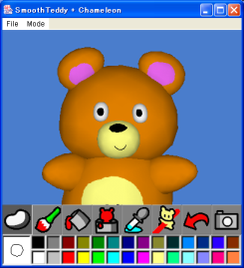
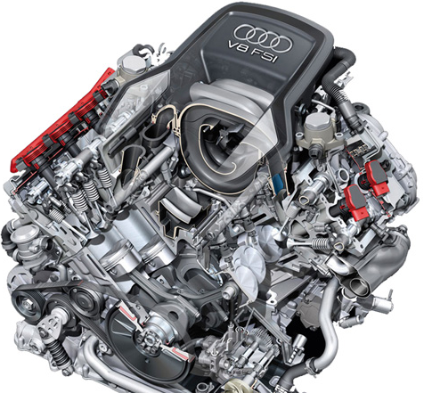
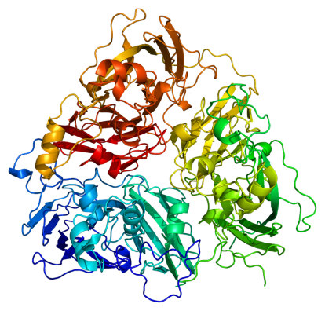
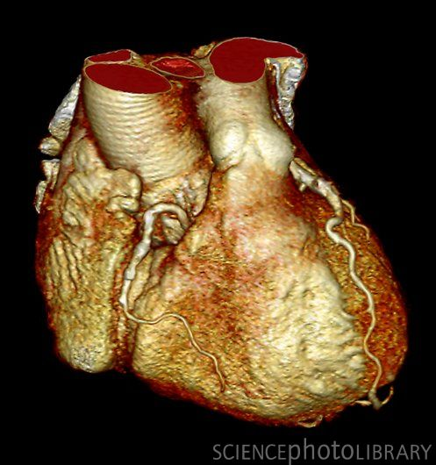

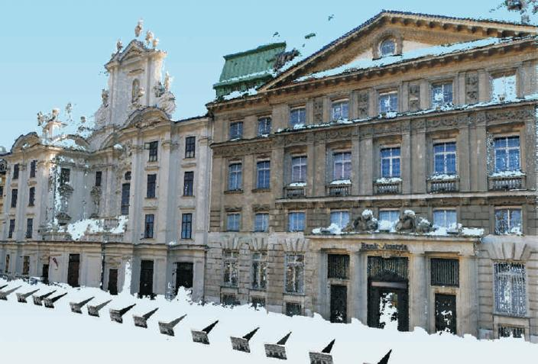
3D Shapes
Large repositories of 3D data are becoming available
Shape Modeling
Mechanical CAD
Molecular Biology
Medicine
Cultural Heritage
Buildings

Slide 5
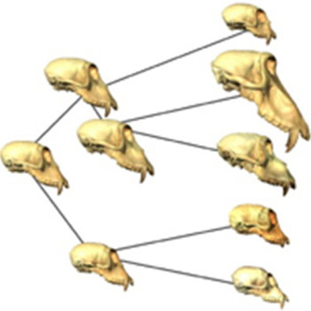

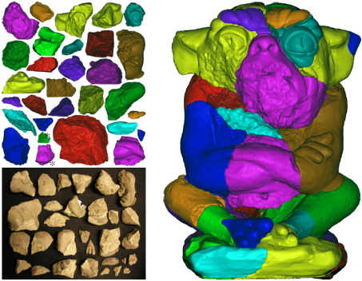
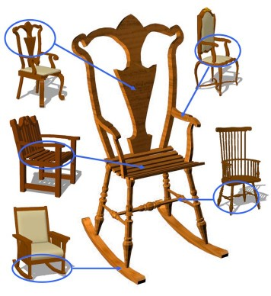
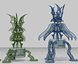
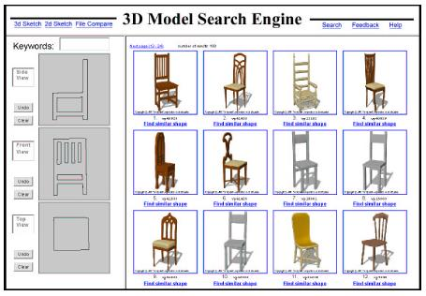
Applications
[Wiley et al.05]
[Cooper et al.10]
[Huang et al.06]
Paleontology
Protein folding
Solving puzzles
[Funkhouser et al.04]
[Gal et al.09]
[Funkhouser et al.05]
Modeling & Editing
Product search

Slide 6
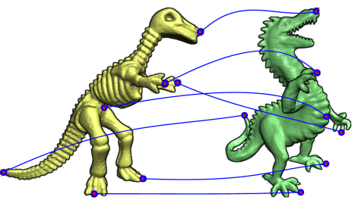
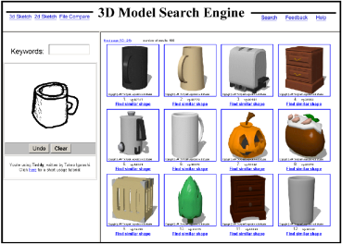
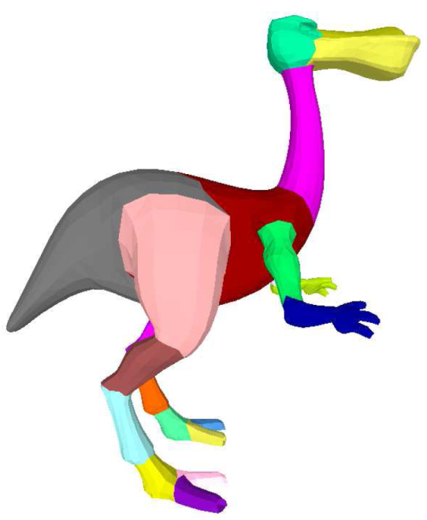
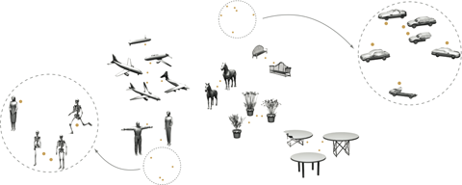
Shape Analysis Tasks
Design algorithms to extract semantic information from one or a collection of shapes
[van Kaick et al. 11]
[Funkhouser et al. 05]
Matching
Retrieval
[Karz and Tal 03]
[Mitra et al. 06]
Segmentation
Classification & Clustering

Slide 7
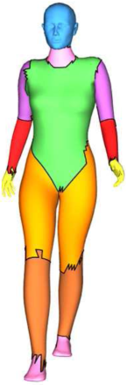
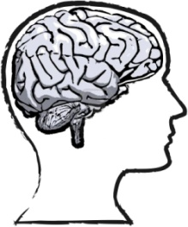
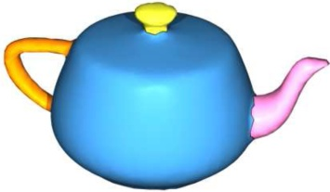
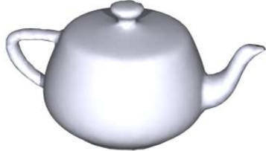
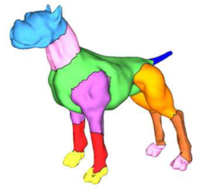
Importance of Shape Segmentation
"How can we decompose a 3D model into parts?"
Psychological research indicates that recognition and shape understanding are based on structural decomposition of the shape into smaller parts [Hoffmann et al. 84,97]
Applications in other shape analysis tasks such as shape matching and shape recognition

Slide 8
Today’s Content
3D shape and its segmentation
Related Segmentation algorithms
Data Driven consistent segmentation
Deep Learning for consistent shape segmentation
Note: Some of today’s lectures are referred to the following sources:
Qixing Huang, etc, Joint Segmentation with Linear Programming, Link
Jian Gao, etc, Clustering Ensemble, Link
L. Cosmo, etc, Consistent partial matching of shape collections via spars modeling, 2016

Slide 9
Review of Shape Segmentation

Slide 10
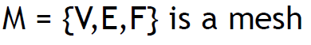
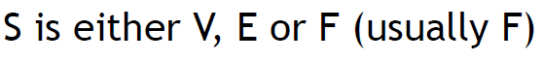
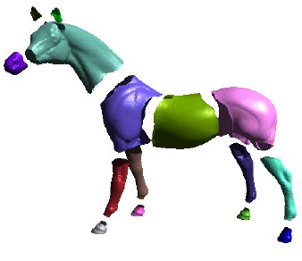
3D object segmentation
M be a 3D mesh,
S the set of mesh elements, which is either V, E or F,
A segmentation of M is the set of sub-meshes = {M₀, M₁... ,M_{k−1}} induced by a partition of S into k disjoint sub-sets.

Slide 11
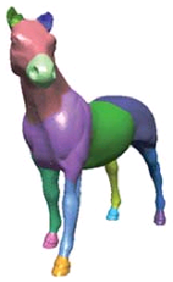
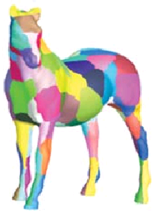
Part-Based Segmentation
Surface-Based Segmentation

Slide 12
Formulate Mesh Segmentation
A criteria function that measures the quality of a partition under a set of constraints
A algorithm for finding the optimal criteria function.
Given a mesh M and the set of elements S ∈ {V, E, F}, find a disjoint partitioning of S into S₀, ..., S_{k−1} such that the criterion function J = J(S₀, ... , S_{k−1}) be minimized (or maximized) under a set of constraints C.

Slide 13
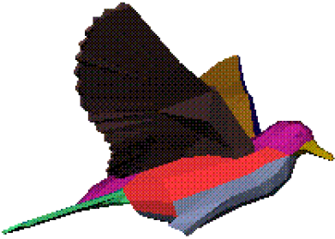
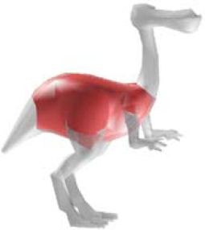
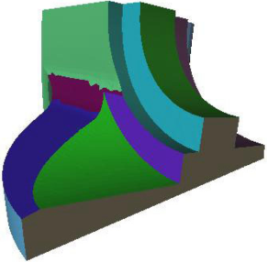
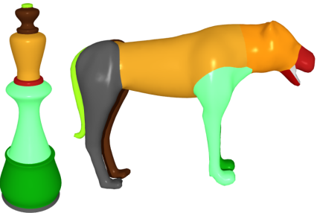
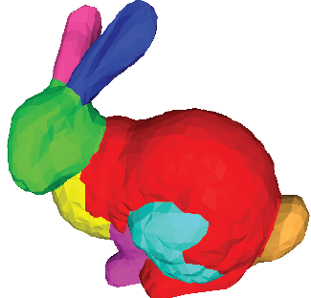
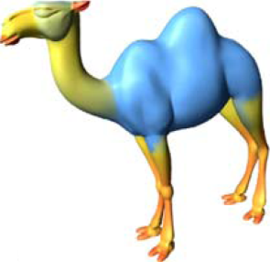
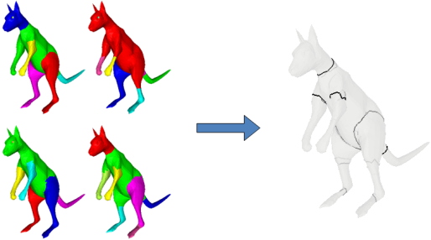
Single-Shape Segmentation
[Shalfman et al. 2002]
[Katz et al. 05]
[Attene et. al 2006]
[Lai et al. 08]
K-Means
Core Extraction
Fitting Primitives
Random Walks
[Golovinskiy and Funkhouser 08]
[Shapira et al. 08]
[Golovinskiy and Funkhouser 08]
Normalized Cuts
Shape Diameter Function
Randomized Cuts

Slide 14
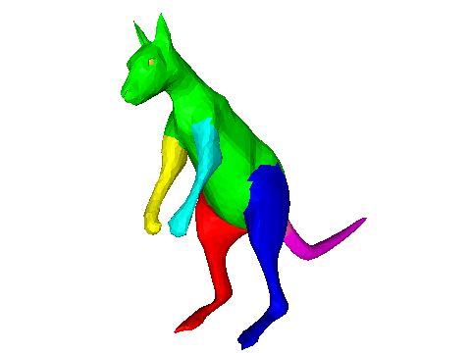
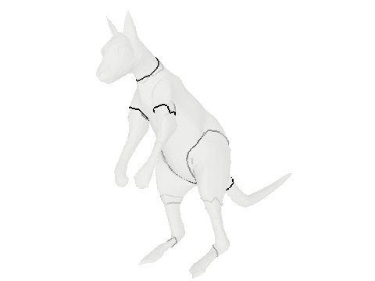
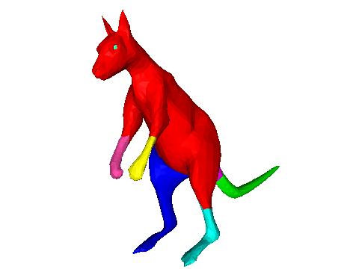
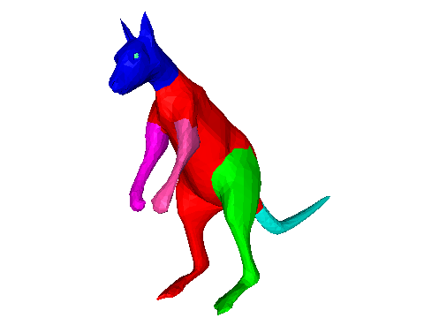
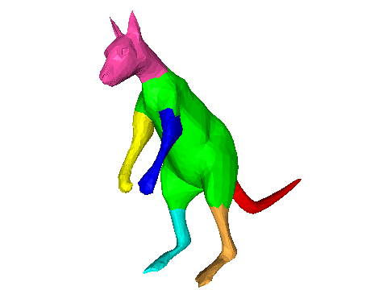
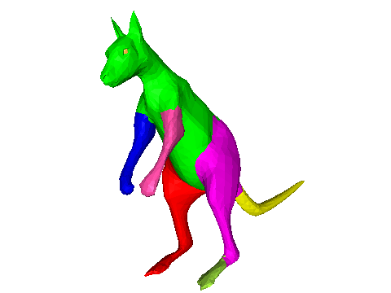
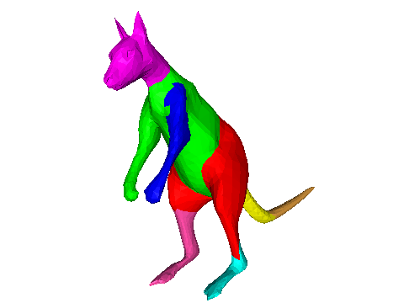
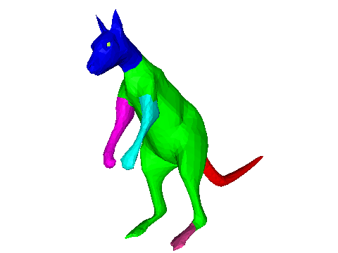
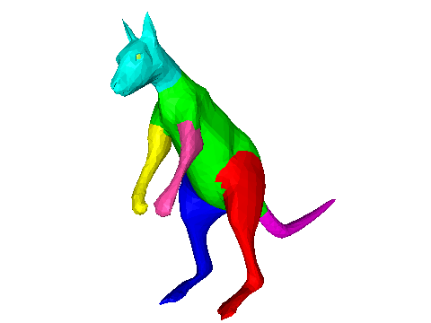
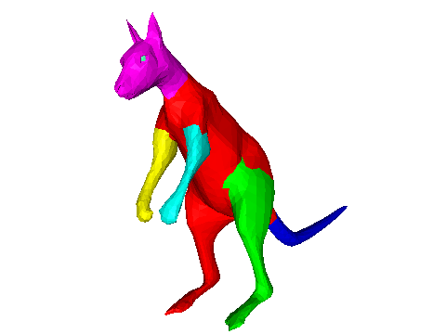
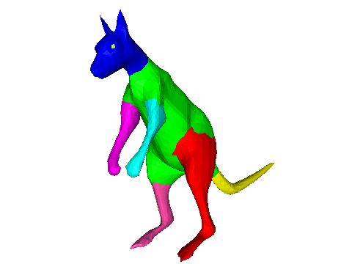
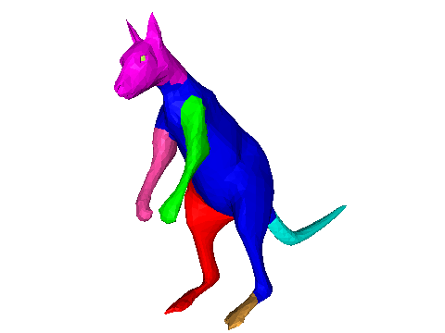
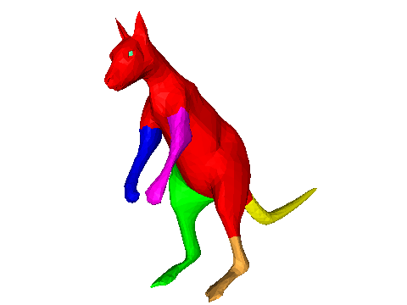
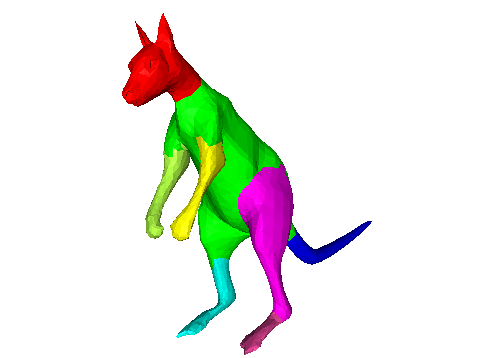
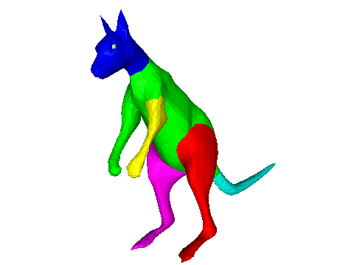
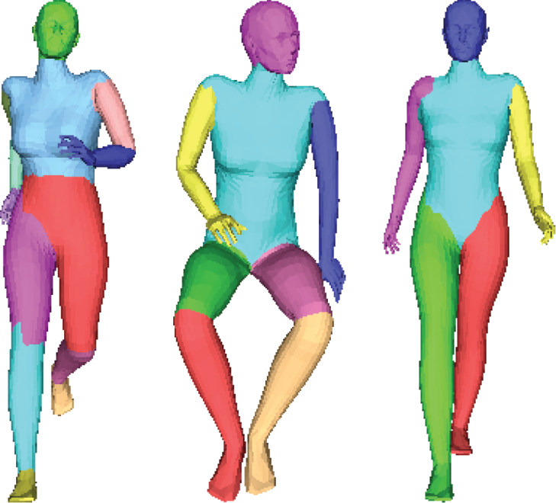
Randomized Cuts [Golovinskiy and Funkhouser 08]
[Slide from Golovinskiy and Funkhouser 08]
Partition Function
Inconsistent across
different poses

Slide 15
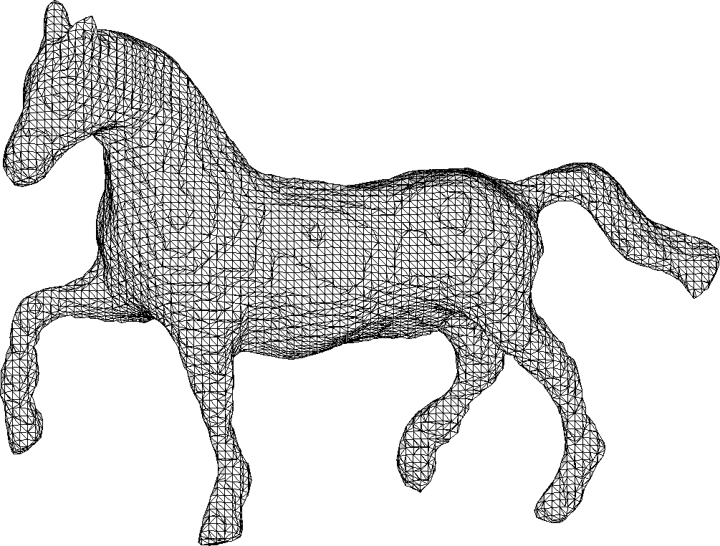
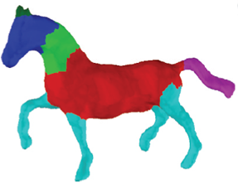
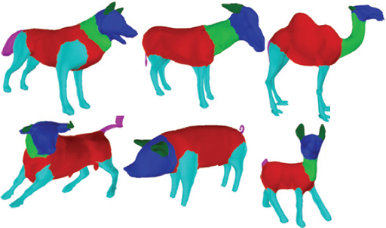

Supervised Methods [Kalogerakis et al.10, van Kaick et al. 11]
[Slide from Kalogerakis et al.10]
Input Mesh
Labeled Mesh
Head
Neck
Torso
Leg
Tail
Training Meshes
Ear
Limitations
Prior knowledge of the category
Shape variation within each category shall be small

Slide 16
Today’s Content
3D shape and its segmentation
Related Segmentation algorithms
Data Driven consistent segmentation
Deep Learning for consistent shape segmentation
Note: Some of today’s lectures are referred to the following sources:
Qixing Huang, etc, Joint Segmentation with Linear Programming, Link
Jian Gao, etc, Clustering Ensemble, Link
L. Cosmo, etc, Consistent partial matching of shape collections via spars modeling, 2016

Slide 17
Motivations of Joint Segmentation

Slide 18












Motivations
Structural similarity of segmentations
Extraneous geometric clues
Single shape segmentation
[Chen et al. 09]
Joint shape segmentation
[Huang et al. 11]

Slide 19


Motivations
Structural similarity of segmentations
Low saliency
Single shape segmentation
[Chen et al. 09]
Joint shape segmentation
[Huang et al. 11]

Slide 20












Motivations
(Rigid) invariance of segments
Articulated structures
Single shape segmentation
[Chen et al. 09]
Joint shape segmentation
[Huang et al. 11]

Slide 21
Method
Multiple Shape Correspondence
Single Shape Segmentation via clustering
Joint Shape Segmentation via consensus clustering

Slide 22
Multiple Shape Correspondence

Slide 23

Model as cycle consistency
This intuition can be generalized to enforcing a cycle-consistency constraint, namely composite maps along cycles should be identity map.

Slide 24
How does cycle consistency work
We do not know which maps or correspondences are incorrect, but we can detect inconsistent cycles.
An inconsistent cycle indicates that at least one of the participating maps or correspondences is incorrect.

Slide 25

Virtual universe

Slide 26

Multiple Shape Correspondence

Slide 27
Joint Shape Segmentation via consensus clustering

Slide 28

Goal
Determine the consistent and better segmentation from the all collection of individual “weak” segmentations

Slide 29

Discover the consistent segmentation
Better Segmentation

Slide 30

Consensus Strategy
Based Individual Segmentation
Vertices
They are not represent the same segment
The goal: get the consensus segmentation

Slide 31
Implementation of consensus strategy
Generating basic clusters for Clustering Label Generation
Label correspondence & Re-labeling
Voting for consensus labeling

Slide 32
Generating basic clusters
Different subsets of features
Different clustering algorithms
Random number of clusters
Random initialization for K-means/K-centers
etc

Slide 33
K-Center for Individual Clustering Label Generation

Slide 34


K-Center clustering
k centers which minimizes the maximum distances from points to their center point
Minimize:
Across clusters
Within a cluster

Slide 35
Farthest-first traversal
Approximation of the solution of K-center NP hard problem

Slide 36
Step 1:
Randomly pick up the point center

Slide 37
Step 2:
Find the point with largest distance to
the first center

Slide 38
Step 3:
Temporarily set this point as the second
center

Slide 39
Step 4:
Clustering the points based on the distances
Two centers

Slide 40
Step 5:
Find the point close to the mean in the
second clusters, set it as the second
center

Slide 41
Step 6:
Find the point with largest distance to both identified center and Temporarily set this point as the third center

Slide 42
Step 7:
Clustering the points based on the distances and three centers

Slide 43
Step 8:
Find the point close to the mean in the
Third clusters, set it as the third
center

Slide 44
Step 9:
Clustering based on the three identified centers and distances

Slide 45


Individual Segment Result for label generation
8
1
3
3
2
1
2
4
5
5
4
6
7

Slide 46
Label correspondence assignment

Slide 47


Slide 48
Label correspondence assignment

Slide 49
Label Correspondence Algorithm
Step 1: Choose a reference clustering
Step 2: Use the point correspondence to re-label the clustering
Step 3: Re-label the points on the candidate shape.

Slide 50

Step 1
1
2
3
1
3
2
Re-Label
Re-Label
Reference Shape for
Label Assignment

Slide 51
Step 2
1
1
1
1
1
1
Re-Label
Re-Label
Reference Shape for
Label Assignment

Slide 52

Alternative representation of Label correspondence %

Slide 53

Optimization for label correspondence

Slide 54
Voting for consensus labeling

Slide 56
Step 3
1
1
1
1
1
1
Re-Label
Re-Label
Reference Shape for
Label Assignment

Slide 57
Today’s Content
3D shape and its segmentation
Related Segmentation algorithms
Data Driven consistent segmentation
Deep Learning for consistent shape segmentation
Note: Some of today’s lectures are referred to the following sources:
Qixing Huang, etc, Joint Segmentation with Linear Programming, Link
Jian Gao, etc, Clustering Ensemble, Link
L. Cosmo, etc, Consistent partial matching of shape collections via spars modeling, 2016

Slide 58
Deep Learning in Shape Registration

Slide 59

Many-to-one encoder: Deep Neural Network
Unique Shape
Deep Shape Feature
Fang, etc, CVPR 2015
Notes:
Let’s recall the Many-to-One We talk before for the shape retreival.

Slide 60

How to model our shape segmentation as a many-to-one?

Slide 61
Samples
Samples from segment one
Samples
Samples from segment Two

Slide 62
Unique
Label
Samples from a consistent segment

Slide 63
Project 3: Data-Driven Consistent Shape Segmentation
A collection of 3D human models at different poses will be provided
Implement single segmentation with K-center clustering algorithm for 3D model segmentation
Consistent segmentation via consensus clustering for the collection of 3D Shapes

